Slide 1
Neural mesh refinement
Zhiwei ZHU, Xiang GAO, Lu YU, Yiyi LIAO, 2025. Neural mesh refinement. Frontiers of Information Technology & Electronic Engineering, 26(5):695-712. https://doi.org/10.1631/FITEE.2400344
Project page: https://zhuzhiwei99.github.io/NeuralMeshRefinement/
Key words: Geometry processing; Mesh refinement; Mesh subdivision; Neural network; Disentangled representation learning; Graph attention
Corresponding author: Lu YU, Yiyi LIAO E-mail: yul@zju.edu.cn; yiyi.liao@zju.edu.cn
ORCID: Lu YU, https://orcid.org/0000-0002-0550-7754; Yiyi LIAO,
https://orcid.org/0000-0001-6662-3022

Slide 2
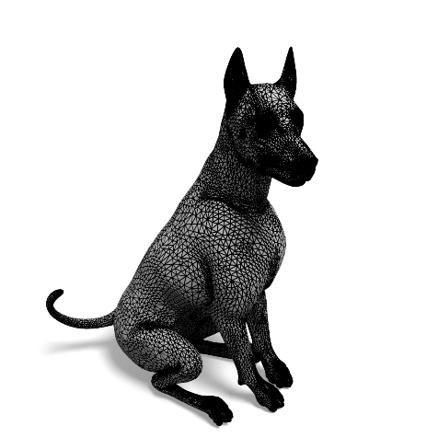
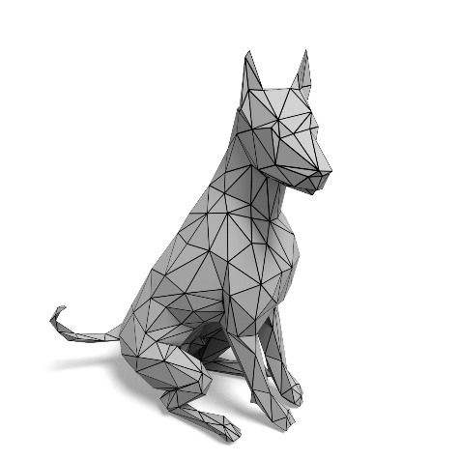
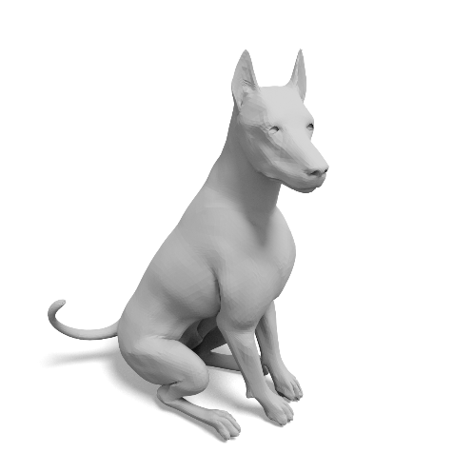
Motivation
Detailed 3D meshes can model complex details but put a strain on storage and transmission. Coarse 3D meshes are favored for efficient storage and quick transmission but struggle to accurately represent fine geometric details. To tackle this trade-off, a practical solution is to store and transmit a coarse mesh and then utilize a refinement method at the user end to restore the details.
trade-off
refine
Detailed
Coarse
Refined

Slide 3
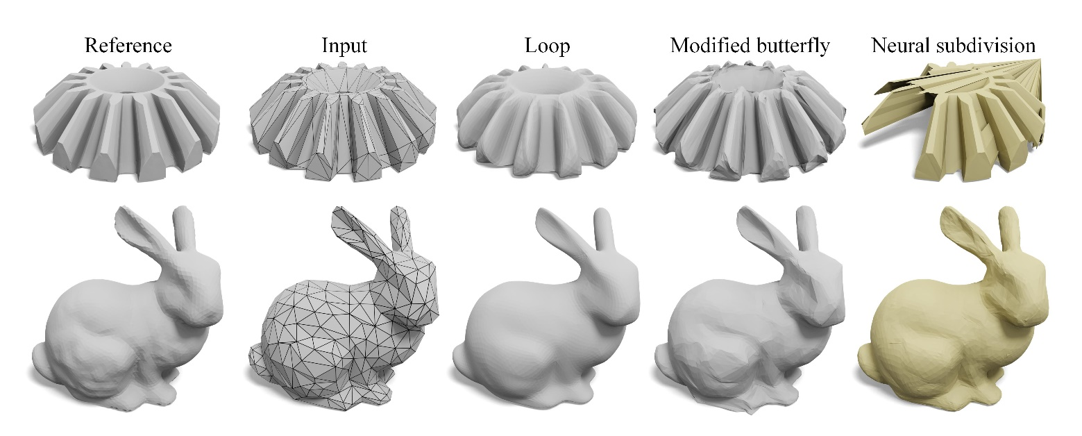
Motivation
Subdivision is a widely used technique for mesh refinement. Classic methods rely on fixed manually-defined weighting rules and struggle to generate a finer mesh with appropriate details, while advanced neural subdivision methods achieve data-driven nonlinear subdivision but lack robustness, suffering from limited subdivision levels and artifacts on novel shapes.
Existing subdivision methods

Slide 4
Main idea
1. To address these issues, we introduces a Neural Mesh Refinement (NMR) method that utilizes the geometric structural priors learned from fine meshes to adaptively refine coarse meshes through subdivision, resulting in refined meshes with more reasonable details and exhibiting robust generalization.
2. Our key insight is that it is necessary to disentangle the network from non-structural information such as scale, rotation, and translation, enabling the network to focus on learning and applying the structural priors of local patches for adaptive refinement. For this purpose, we propose an intrinsic structure descriptor and a locally adaptive neural filter.

Slide 5
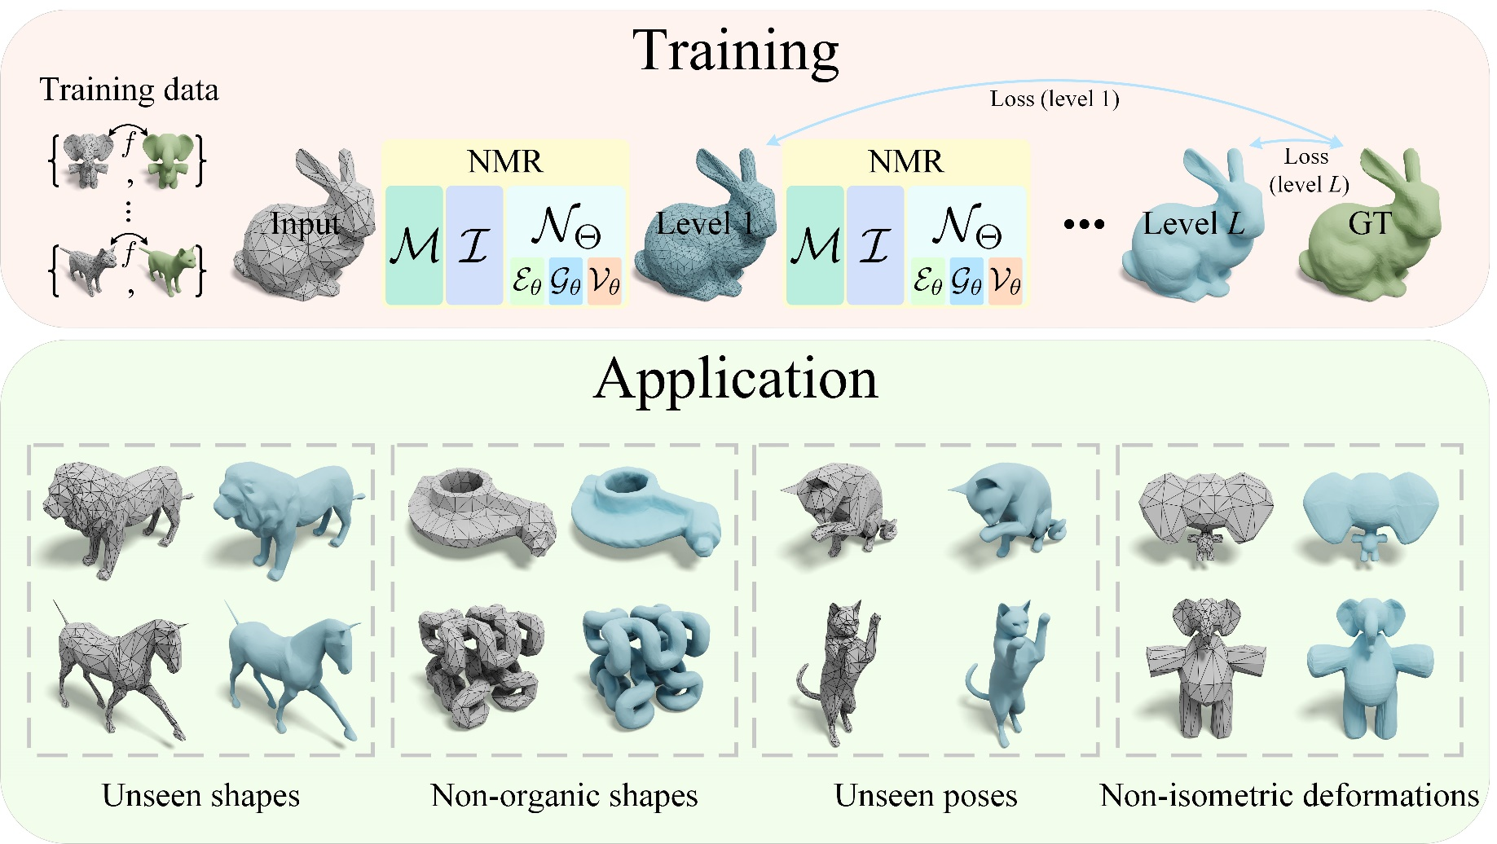
Overview
Neural Mesh Refinement (NMR) performs data-driven nonlinear refinement and demonstrates robust generalization to unseen shapes, poses, and non-isometric deformation. It can also refine coarse non-organic shapes into finer ones with appropriate geometric details, even when trained on organic shapes.

Slide 6
Method
NMR processes a coarse triangle mesh (gray) to produce a sequence of subdivided meshes (blue) with varying levels of detail. During training, we minimize the Charbonnier loss between the ground truth (green) and the output meshes (blue) across levels. Our training data comprises pairs of coarse and fine meshes (left) with a bijective map between each pair. Each refinement involves the processing of three modules:
Midpoint subdivision
Intrinsic structure descriptor
Neural filter
Refinement pipeline of NMR

Slide 7
Method
Midpoint subdivision: The original face is subdivided into four faces by inserting new vertices at the midpoint of each edge and connecting new vertices through new edges.
Intrinsic structure descriptor: For newly inserted vertices, an intrinsic structure descriptor is created by normalizing their one-ring neighborhood. This normalization makes the features invariant to scale, rotation, and translation, allowing the network to focus on extract structural priors.
Midpoint subdivision and intrinsic structure descriptor

Slide 8
Method
3. Neural Filter: This filter predicts offsets for the new vertices to update their positions. It consists of:
Edge Feature Embedding: Capture features from the outgoing edges of the central vertex.
Graph Attention Aggregation: Aggregate edge features to the central vertex using a graph attention mechanism, adaptively emphasizing relevant local structures.
Vertex Repositioning: Predict residual from the central vertex feature to refine its position.
Architecture of neural filter

Slide 9
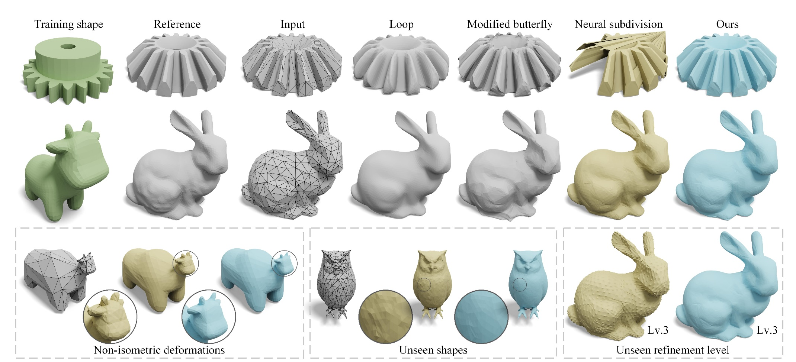
Major results
NMR does not suffer from the inherent limitations of existing methods, such as volume shrinkage and over-smoothing (Loop), amplification of tessellation artifacts (modified butterfly), or shape damage (neural subdivision). Moreover, it outperforms neural subdivision in generalization across non-isometric deformations, unseen shapes, and unseen refinement levels.

Slide 10
Major results
NMR outperforms all baseline methods on the TOSCA dataset and exhibits significant advantages across all evaluation metrics.
NMR produces finer meshes closer to the ground truth, successfully addressing issues encountered in other methods, such as over-smoothing, volume shrinkage, and artifacts.

Slide 11
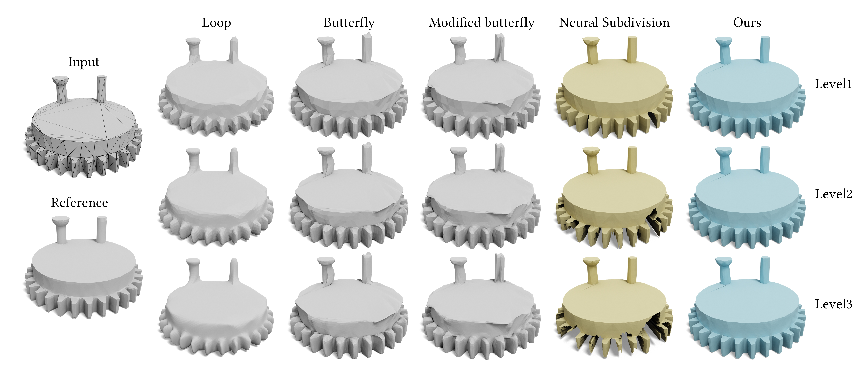
Major results
NMR outperforms all baseline methods on the Thingi10K dataset and exhibits significant advantages across all evaluation metrics.
Classical methods encounter issues with volume shrinkage and amplification of tessellation artifacts. Neural subdivision disrupt the mesh shape. In contrast, our method robustly preserves the original shape

Slide 12
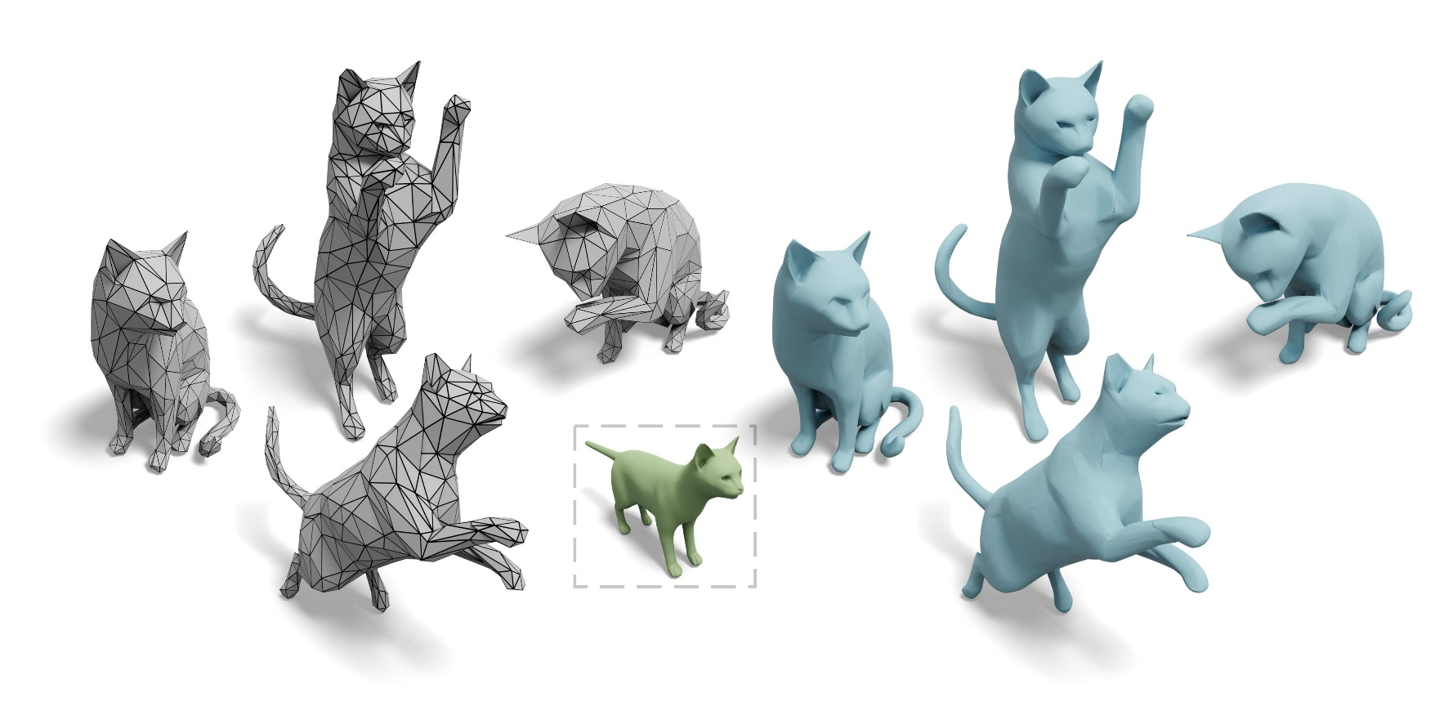
Applications
We mimic the modeling scenario by applying isometric deformations to the coarse cage (gray), resulting in various poses. NMR can generalize to refining unseen poses (blue).

Slide 13
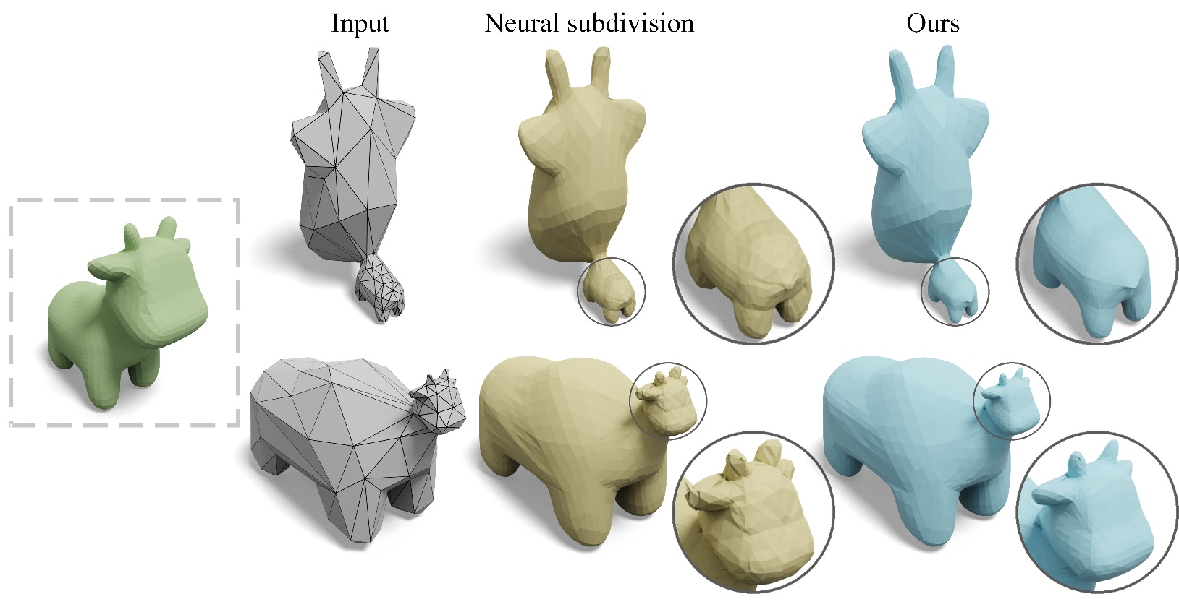
Applications
We mimic the modeling scenario by applying non-isometric deformations to the coarse cage (gray). NMR generalizes well to unseen non-isometric deformations compared to neural subdivision.

Slide 14
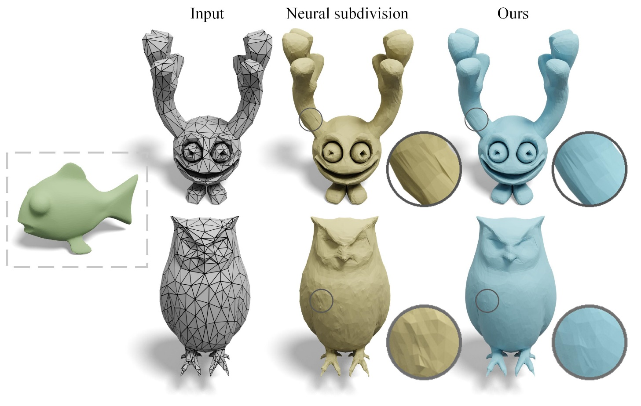
Applications
Even when trained on a single shape (green fish), NMR can generalize to refining unseen shapes and outperform neural subdivision.

Slide 15
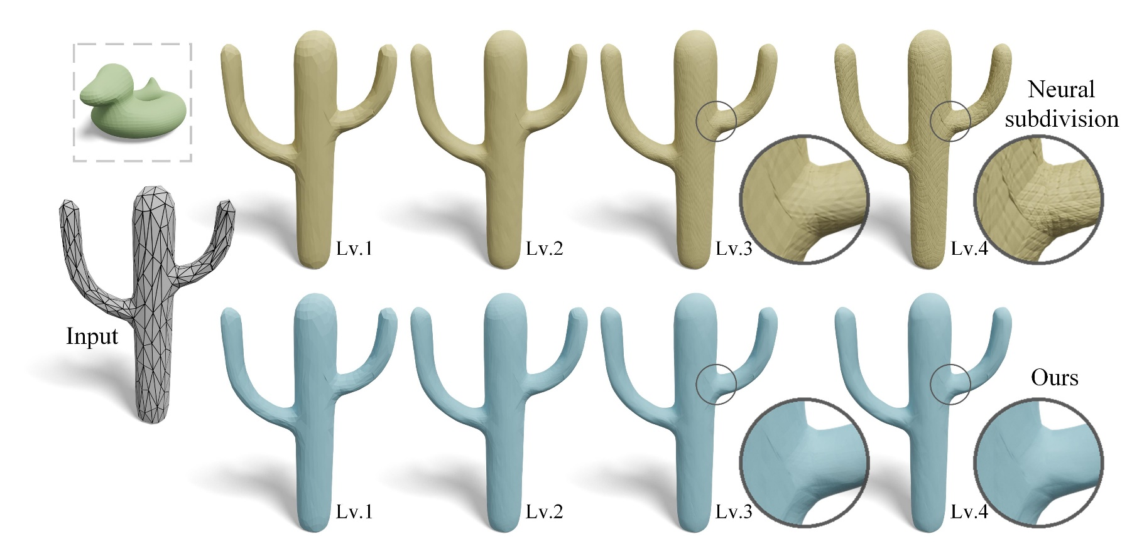
Applications
Even when the test refinement level exceeds the training level, NMR can still output a reasonably smooth surface, while neural subdivision cannot.

Slide 16
Applications
When trained on a single shape, NMR exhibits style transfer characteristics. Using different shapes in training leads to stylized refinement results (blue) biased towards the training shapes (green).

Slide 17
Conclusion
We propose a data-driven neural mesh refinement (NMR) method that performs adaptive refinement and exhibits robust generalization.
Our main contribution is that we propose and demonstrate that disentangling the network from non-structural information (e.g., scale, rotation, and translation) allows the network to focus on learning and applying structural priors for adaptive refinement.
Extensive experiments demonstrate that the proposed method outperforms state-of-the-art (SOTA) mesh subdivision methods.

Slide 18
Zhiwei Zhu received his B.Eng. degree in Electronic Information Engineering from Tianjin University, Tianjin, China, in 2021. He is currently a Ph.D. candidate in Information and Communication Engineering at the College of Information Science and Electronic Engineering, Zhejiang University, Hangzhou, China. His research interests include 3D computer vision, machine learning and visual media coding.
Xiang Gao received the B.Eng. degree in communication engineering from Wuhan University of Technology, Wuhan, China, in 2022, and the master’s degree in electronics and information engineering from Zhejiang University, Hangzhou, China, in 2025. His research interests include image/point cloud/gaussian splatting compression and signal processing.

Slide 19
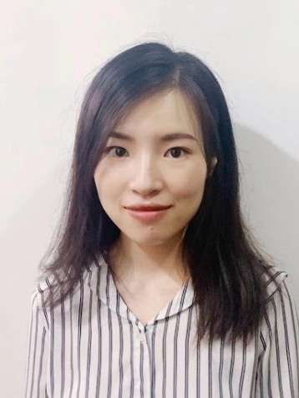
Yiyi Liao is an assistant professor at Zhejiang University, leading the X-Dimensional Representations Lab. She received her Ph.D. in Control Science and Engineering from Zhejiang University in June 2018 and her B.S. degree from Xi’an Jiaotong University in 2013. Her research interests include 3D computer vision and machine learning.
Lu Yu (Senior Member, IEEE) received the B.Eng. degree in radio engineering and the Ph.D. degree in communication and electronic systems from Zhejiang University. She is currently a Distinguished Professor with Zhejiang University. She authored more than 150 peer-reviewed papers on image and video coding, quality assessment, and hardware architecture design, and contributed more than 100 adopted technical proposals to define a series of IEEE, ISO/IEC, as well as ISO/IEC and ITU-T joint standards. She is the Convenor of ISO/IEC JTC 1/SC 29/WG 4 MPEG Video Coding, one of the voting members of the Standard Activities Sub Division of IEEE Circuits and Systems Society, and on the Editorial Board of the IEEE TRANSACTIONS ON CIRCUITS AND SYSTEMS FOR VIDEO TECHNOLOGY.

